Slide 1
ATTENTION IS ALL YOU NEED

Slide 2
PREVIOUS WORKS
Pre-2014 - RNN, LSTM, GRU
RNNs struggled with long sequence data
Could not handle long sequence lengths (forgetful)
Slow to train (inefficient / not parallelizable)
Suffer from exploding or vanishing gradients
Cannot handle very long-term dependencies
The Idea of Attention:
"Attention allows the model to focus on relevant parts of the input sequence dynamically, making it efficient and effective."
"Instead of processing tokens sequentially, attention processes the entire sequence simultaneously, capturing relationships between all tokens."

Slide 3
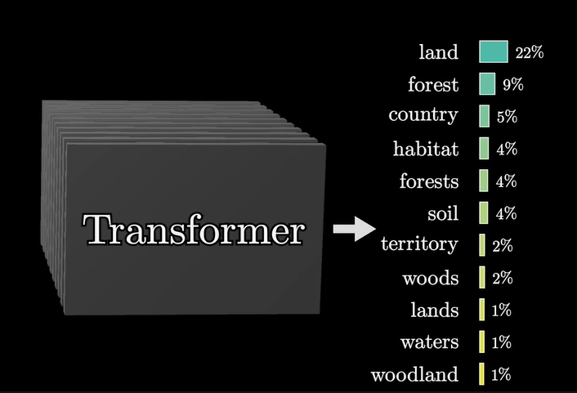
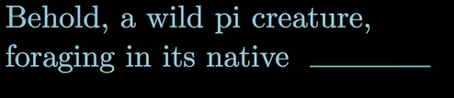
What transformers actually do

Slide 4
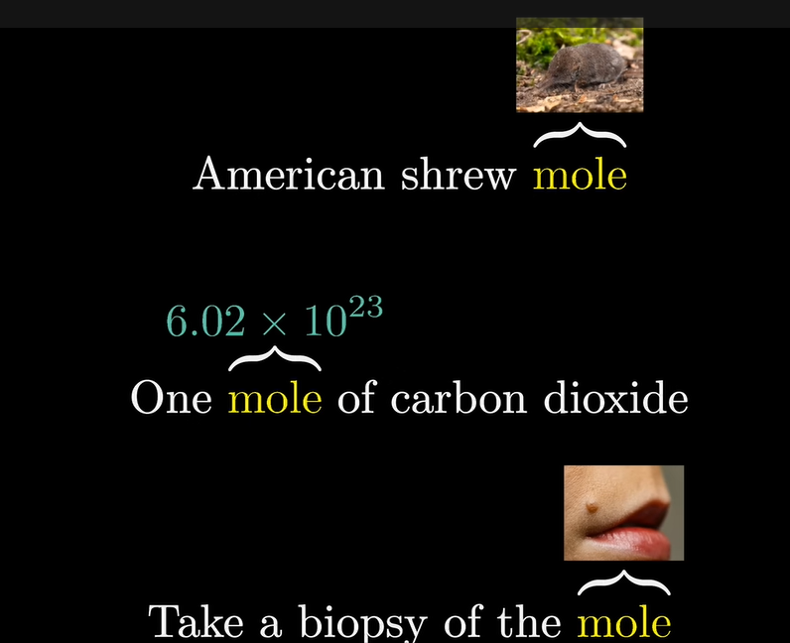

Slide 5
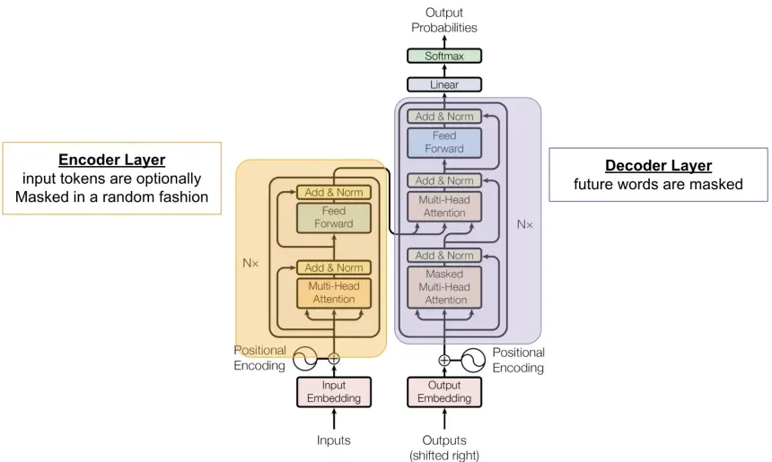
FULL ARCHITECTURE

Slide 6
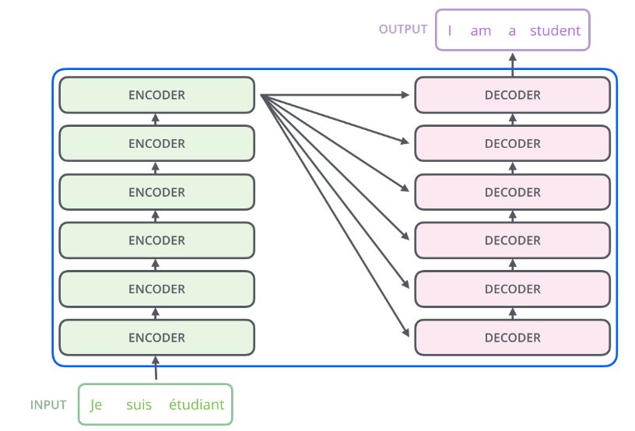

Slide 7
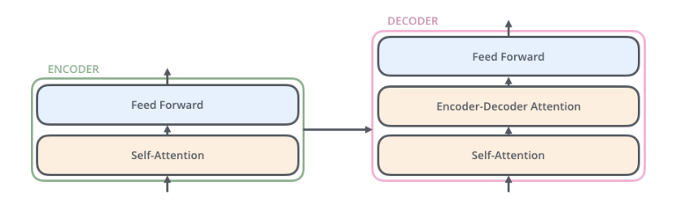
"The Transformer is made up of two main parts: the encoder and the decoder."
Encoder: Takes the input sequence and creates contextualized embeddings.
Decoder: Uses these embeddings to generate the output sequence.

Slide 8
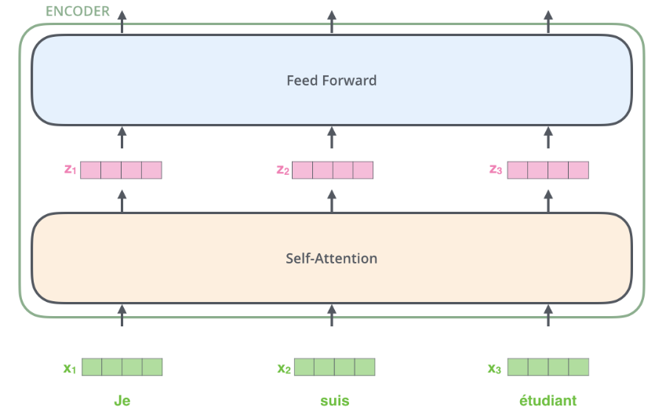

Slide 9
Input
What is Tokenization?
Tokenization is the process of breaking down text into smaller units called tokens. Think of it as chopping up a sentence into meaningful pieces that a computer can process.
Types of Tokenization
Word Tokenization
Splits text into individual words
Example: "I love NLP" → ["I", "love", "NLP"]
Handles basic punctuation and spacing
Common in traditional NLP applications
Subword Tokenization
More sophisticated approach used by modern language models
Breaks words into meaningful subunits
Example: "understanding" → ["under", "stand", "ing"]
Handles rare words and morphological variations better
Popular algorithms: BPE (Byte-Pair Encoding), WordPiece, SentencePiece

Slide 10
What are Embeddings?
Embeddings are dense vector representations of tokens in a continuous vector space. They capture semantic relationships between words in a format that machines can understand and process.
Key Characteristics
Dimensionality
Typically 100-1000 dimensions
Each dimension captures different semantic aspects
Balance between expressiveness and computational efficiency
Semantic Relationships
Similar words cluster together in the vector space
Captures analogies and relationships
Example: king - man + woman ≈ queen

Slide 11
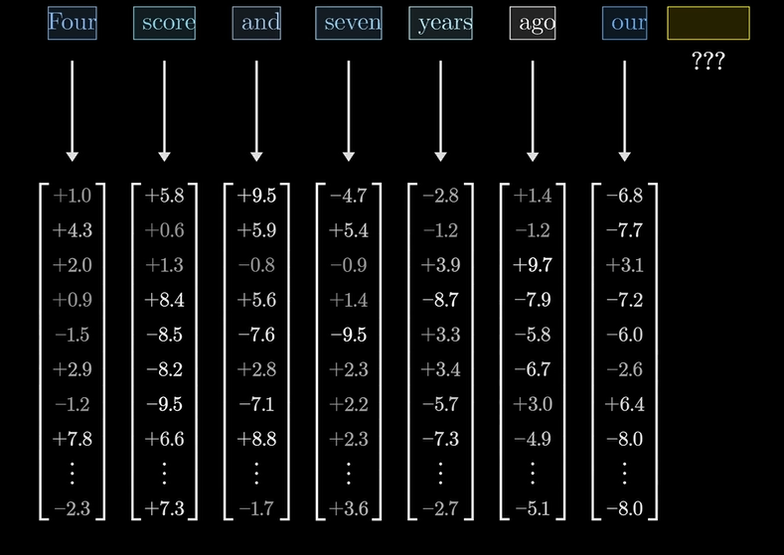

Slide 12
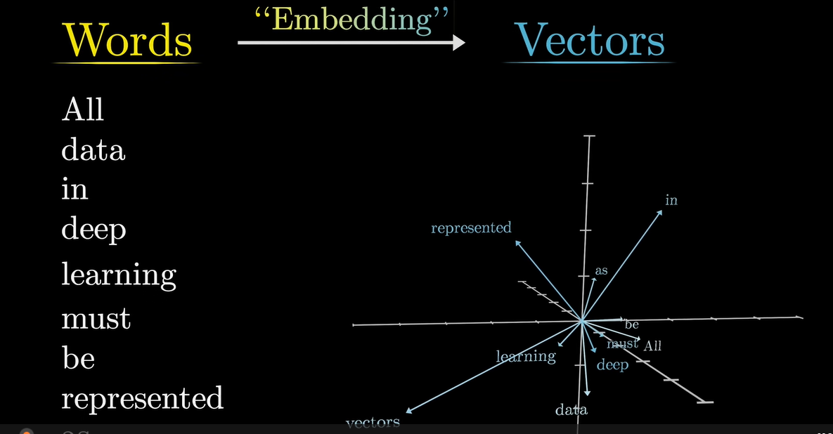

Slide 13
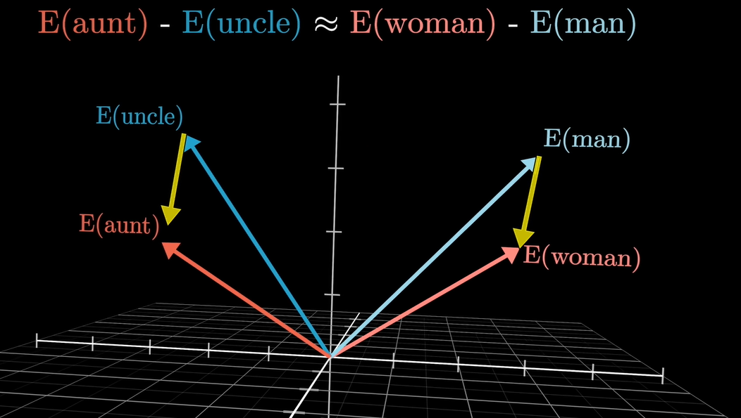

Slide 14
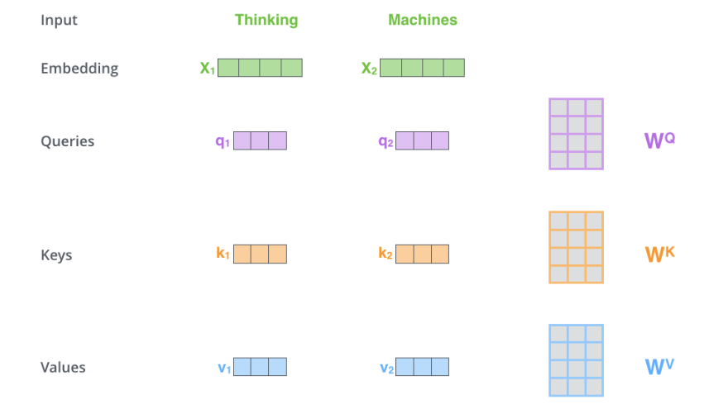

Slide 15
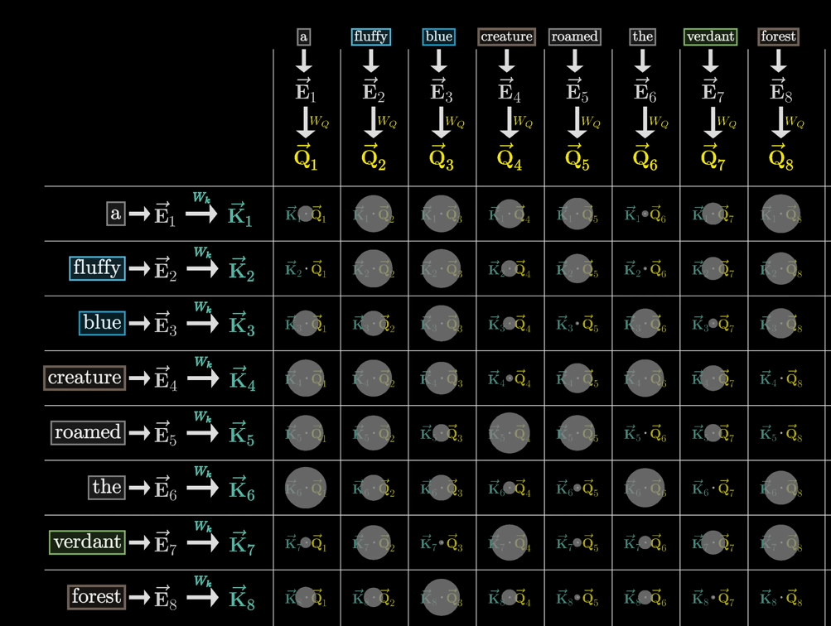

Slide 16
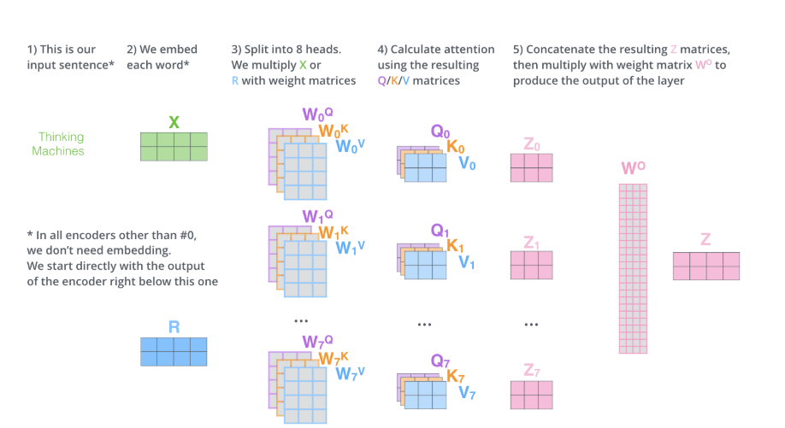

Slide 17


Slide 18


